Slide 1
Research Methodology
Priya K
Assistant Professor
Dept.of CSE, RIT

Slide 2
Contents
Meaning of Research,
Objectives of Research,
Types of Research,
Ethics in Research,
Types of Research Misconduct.
Literature Review and Technical Reading

Slide 3


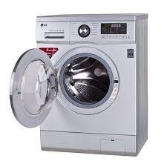
MEANING OF RESEARCH

Slide 4
MEANING OF RESEARCH
Research in common parlance refers to a search for knowledge.
Once can also define research as a scientific and systematic search for pertinent information on a specific topic.
A careful investigation or inquiry especially through a search for new facts in any branch of knowledge.
1 Redman and Mory define research as a “systematized effort to gain new knowledge in their work “romance of research”
2 Some people consider research as a movement, a movement from the known to the unknown. It is actually a voyage of discovery.

Slide 5
MEANING OF RESEARCH
Research is an academic activity
Clifford Woody (American psychologists) research comprises
Defining and redefining problems,
Formulating hypothesis or suggested solutions;
Collecting, organizing and evaluating data;
Making deductions and reaching conclusions;
and at last carefully testing the conclusions to determine whether they fit the formulating hypothesis.

Slide 6
MEANING OF RESEARCH
D. Slesinger and M. Stephenson in the Encyclopaedia of Social Sciences define research as
The manipulation of things, concepts, or symbols for the purpose of generalizing to extend,
Correct or verify knowledge,
Whether that knowledge aids in the construction of theory or in the practice of an art.”
Research is, thus, an original contribution to the existing stock of knowledge making for its advancement.
It is the pursuit of truth with the help of study, observation, comparison and experiment.

Slide 7
OBJECTIVES OF RESEARCH
The purpose of research is to discover answers to questions through the application of scientific procedures.
The main aim of research is to find out the truth which is hidden and which has not been discovered as yet.
Though each research study has its own specific purpose, we may think of research objectives as falling into a number of following broad groupings:
1. To gain familiarity with a phenomenon or to achieve new insights into it (studies with this object in view are termed as exploratory or formative research studies);
2. To portray accurately the characteristics of a particular individual, situation or a group (studies with this object in view are known as descriptive research studies);
3. To determine the frequency with which something occurs or with which it is associated with something else (studies with this object in view are known as diagnostic research studies);
4. To test a hypothesis of a causal relationship between variables (such studies are known as hypothesis-testing research studies)

Slide 8
MOTIVATION IN RESEARCH
The possible motives for doing research may be either one or more of the following:
1. Desire to get a research degree along with its consequential benefits;
2. Desire to face the challenge in solving the unsolved problems, i.e., concern over practical problems initiates research;
3. Desire to get intellectual joy of doing some creative work
4. Desire to be of service to society
5. Desire to get respectability

Slide 9
TYPES OF RESEARCH
The basic types of research are as follows:
Descriptive vs. Analytical
Applied vs. Fundamental
Quantitative vs. Qualitative
Conceptual vs. Empirical
Some Other Types of Research

Slide 10

TYPES OF RESEARCH : Descriptive vs. Analytical

Slide 11
TYPES OF RESEARCH : Descriptive vs. Analytical
Descriptive research includes surveys and fact-finding inquiries of different kinds.
The major purpose of descriptive research is description of the state of affairs as it exists at present.
The main characteristic of this method is that the researcher has no control over the variables; he can only report what has happened or what is happening.
Most ex post facto(from a thing done afterward) research projects are used for descriptive studies in which the researcher seeks to measure such items as, for example, frequency of shopping, preferences of people, or similar data.
Ex post facto studies also include attempts by researchers to discover causes even when they cannot control the variables.
The methods of research utilized in descriptive research are survey methods of all kinds, including comparative and correlational methods.
In analytical research, on the other hand, the researcher has to use facts or information already available and analyze these to make a critical evaluation of the material.

Slide 12

TYPES OF RESEARCH : Applied vs. Fundamental

Slide 13
TYPES OF RESEARCH : Applied vs. Fundamental
Applied research aims at finding a solution for an immediate problem facing a society or an industrial/business organization, whereas fundamental research is mainly concerned with generalizations and the formulation of a theory.
Example: Research concerning some natural phenomenon or relating to pure mathematics are examples of fundamental research.
Example: research studies, concerning human behaviour carried on with a view to making generalizations about human behavior, are also examples of fundamental research, but research aimed at certain conclusions (say, a solution) facing a concrete social or business problem is an example of applied research.
Example: Research to identify social, economic or political trends that may affect a particular institution or copy research marketing research or evaluation research are examples of applied research.
Thus, the central aim of applied research is to discover a solution for some pressing practical problem, whereas basic research is directed towards finding information that has a broad base of applications and thus, adds to the already existing organized body of scientific knowledge

Slide 14

TYPES OF RESEARCH : Quantitative vs. Qualitative

Slide 15
TYPES OF RESEARCH : Quantitative vs. Qualitative
Quantitative research is based on the measurement of quantity or amount.
Qualitative research, on the other hand, is concerned with qualitative phenomenon, i.e., phenomena relating to or involving quality or kind.
For instance, when we are interested in investigating the reasons for human behavior (qualitative research)
This type of research aims at discovering the underlying motives and desires, using in-depth interviews for the purpose.
Other techniques of such research are word association tests, sentence completion tests, story completion tests, and similar other projective techniques.
Attitude or opinion research i.e., research designed to find out how people feel or what they think about a particular subject or institution is also qualitative research.
Through such research we can analyse the various factors which motivate people to behave in a particular manner or which make people like or dislike a particular thing.
one should seek guidance from experimental psychologists.

Slide 16
TYPES OF RESEARCH : Conceptual vs. Empirical
Conceptual research is that related to some abstract idea(s) or theory.
It is generally used by philosophers and thinkers to develop new concepts or to reinterpret existing ones.
Empirical research relies on experience or observation alone, often without due regard for system and theory.
It is data-based research, coming up with conclusions that are capable of being verified by observation or experiment. We can also call it as experimental type of research.
In such research, the researcher must first provide himself with a working hypothesis or guess as to the probable results.
He then works to get enough facts (data) to prove or disprove his hypothesis.
He then sets up experimental designs
Such research is thus characterized by the experimenter’s control over the variables

Slide 17
TYPES OF RESEARCH : Some Other Types of Research
All other types of research are variations of one or more of the above stated approaches, based on either the
purpose of research,
the time required to accomplish research,
the environment in which research is done,
or on the basis of some other similar factor.
From the point of view of time, we can think of research either as one-time research or longitudinal research.
Research can be field-setting research or laboratory research or simulation research, depending upon the environment in which it is to be carried out.
Research can also be understood as clinical or diagnostic research.
Such research follows case-study methods. Such studies usually go deep into the causes of things or events that interest us, using very small samples and very deep probing data gathering devices.

Slide 18
TYPES OF RESEARCH : Some Other Types of Research
The research may be exploratory or it may be formalized.
The objective of exploratory research is the development of hypotheses rather than their testing, whereas formalized research studies are those with substantial structure and with specific hypotheses to be tested.
Historical research is that which utilizes historical sources like documents, remains, etc. to study events or ideas of the past, including the philosophy of persons and groups at any remote point in time.
Research can also be classified as conclusion-oriented and decision-oriented.
While doing conclusion-oriented research, a researcher is free to pick up a problem, redesign the enquiry as he proceeds and is prepared to conceptualize as he wishes.
Decision-oriented research is always for the need of a decision maker and the researcher in this case is not free to embark upon research according to his own inclination.

Slide 19
Ethics in Research
Provides guidelines for the responsible conduct of research.
Some ethical principles are
Honesty
Objectivity
Integrity
Carefulness
Openness
Respect for Intellectual Property
Confidentiality

Slide 20

What are research misconducts?
Research Misconduct can be characterised as actions or questionable research practices that fall short of the standards of ethics, research and scholarship required to ensure that the integrity of research is upheld. It can cause harm to people and the environment, wastes resources, undermines the research record and damages the credibility of research.

Slide 21
TYPES OF RESEARCH Misconduct
Fabrication - making up data or results and recording or reporting them.(Reporting experiments, observations, or procedures that were never conducted.)
Falsification - manipulating research materials, or changing or omitting data or results such that the research is not accurately represented in the research record.(Changing values in a dataset to improve the appearance of results.)
Plagiarism - the appropriation of another person's ideas, processes, results, or words without giving appropriate credit.(Presenting someone else's work as one's own.
Example: Copying text from a published article without citation.
)

Slide 22
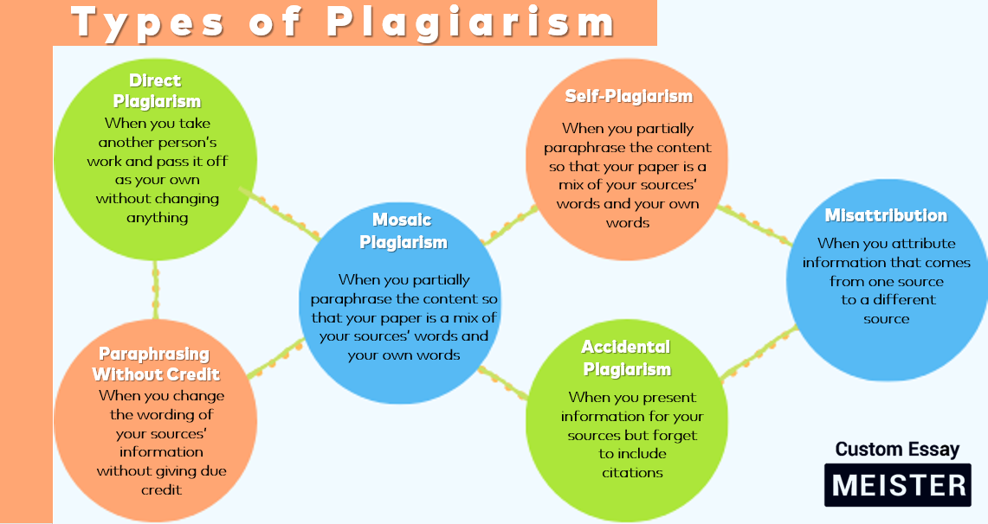
Types of Plagiarism
Example of Misattribution
Incorrect: “According to Smith (2020), water pollution is mainly caused by plastic waste.” (But this idea was actually from Johnson, 2019, not Smith.)

Slide 23
Literature Review and Technical Reading

Slide 24
Literature search
Check to see if your idea is original
Get articles
Read articles and their references
Most of these will be vital when writing up reports
Find gap areas
Find obsolete measurements and results
Define objectives of the study

Slide 25
Steps involved in a research
Choose a subject
Literature survey
Defining and formulation of specific objectives
Prepare Synopsis
Procuring of suitable apparatus/materials
Design of experimental set up
Preliminary experiments
Execution of the project
Accurate measurements/data collection

Slide 26
Steps involved in a research…
Data analysis and error compounding
Hypothesis testing and verification
Results and discussion
Generalization, interpretation and drawing conclusions
Preparation of the project report or writing thesis

Slide 27
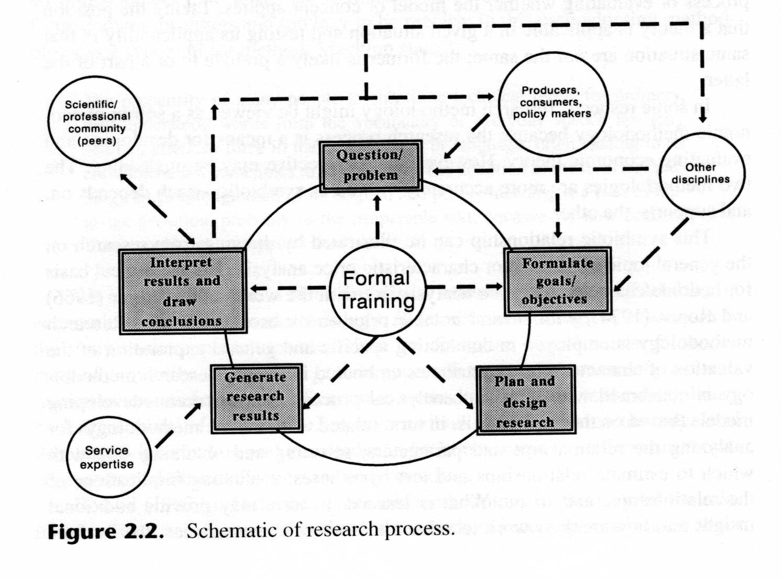
The Process of Research
1
5
2
4
3

